Slide 1

Kofax Today
David.Wright@Kofax.com
Partner Development Manager

Slide 2
Wifi: twelve 12twelve
David.Wright@Kofax.com
Partner Development Manager

Slide 4
Agenda
Introduction
Day 2 is hands on : 4 Kofax Experts covering the entire product portfolio
Hyperautomation
Where is Kofax Today?
Roadmap themes
Cloud
AI and Accuracy
Customer Experience, Continuous Engagement
Customer Engagement

Slide 5
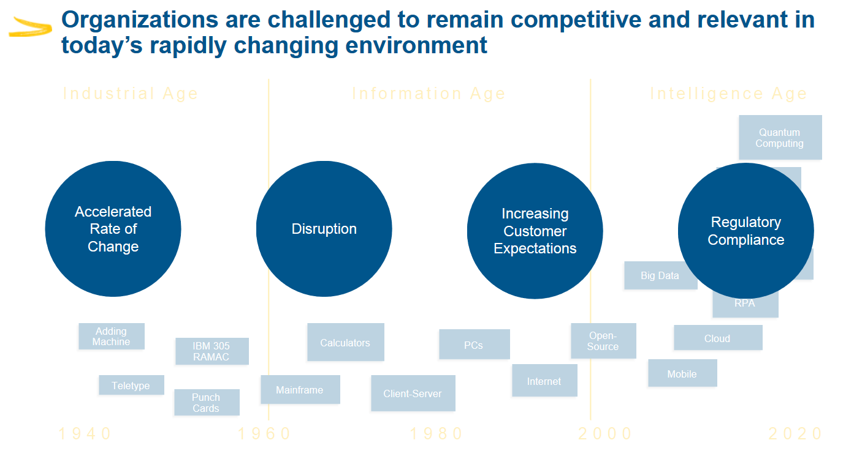



Notes:
We have been living through a century of massive change in industry, information, and now perhaps the intelligence age. Cloud, pandemic, climate, war are now all front of mind.
We are in a phase of consolidation and optimization of new technologies.

Slide 6





Market Themes that Shape our Strategy
Digital Transformation Spend
Exponential Growth in Business Data
Automation Convergence and Democratization
Cloud Adoption
Software Reshaping Every Industry
$2.8T / 16.4% CAGR
2x Every 2 Years
20% YoY
4:1
30% → 95%
17% → 90%
Annual Direct Digital Transformation spend by 2025, which is a 16.4% CAGR between 2021 and 2025
Volume of data 2x every 2 years driven by advanced technologies such as Cloud, IoT, Sensors, Mobile & AR/VR
Rating increase in companies’ desire to integrate iBPMS, OCR, and RPA vs. other common technologies
Citizen to Professional Developers ratio by 2023
Percent of new digital workloads deployed on cloud-native platforms by 2025
S&P 500 value created through Intangible Assets (aka SW) from 1975 to 2020
Source: IDC, Visual Capitalist, Gartner, Deloitte and McKinsey & Company.

Slide 7



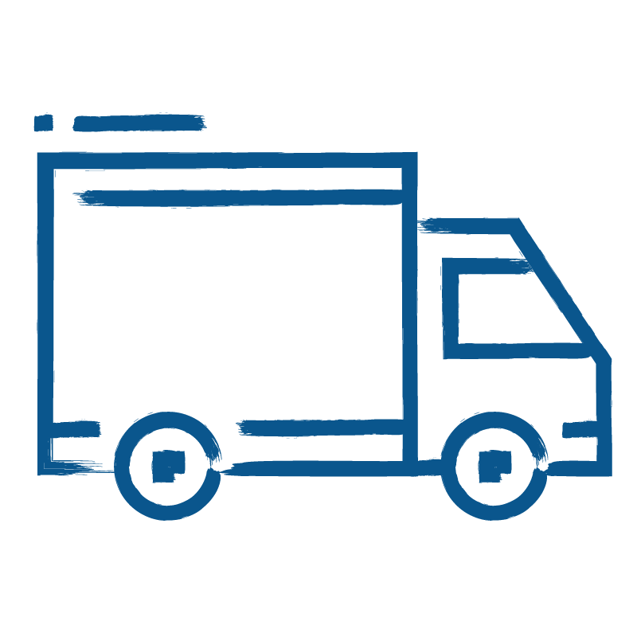
86% of Kofax’ Market in 2021 came from 4 sectors
Banking
and Finance
Health
Public
Sector
Supply & Logistics

Slide 8
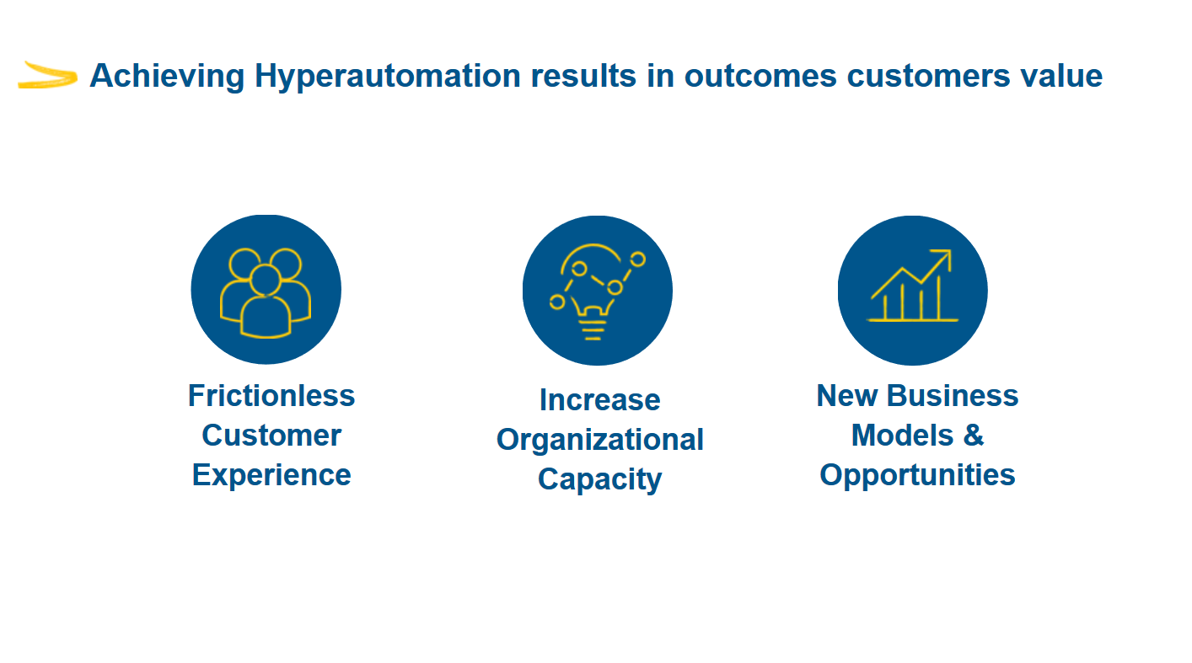
Notes:
People can get what they need, fast, seamlessly and transparently.
Works are happier, focused, relaxed and can be more creative.
This unleashes new possibilities.

Slide 9
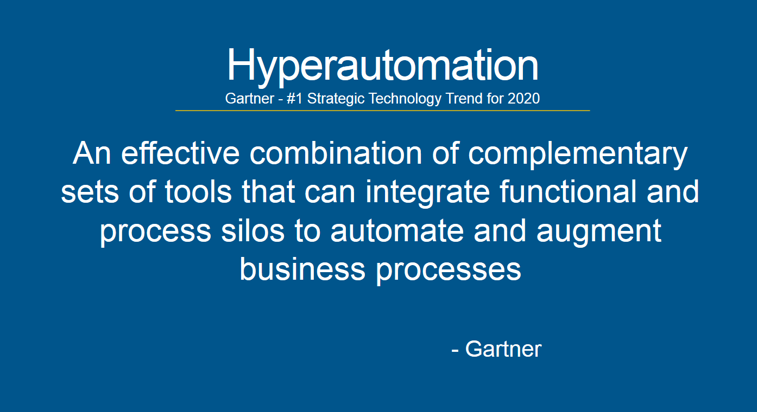
Notes:
Hyperautomation is bringing together all the tools we’ve had now for nearly 40 years. And it is our job to make this personal and benefit the people working for our customers.

Slide 10
Notes:
People can get what they need, fast, seamlessly and transparently.
Works are happier, focused, relaxed and can be more creative.
This unleashes new possibilities.

Slide 11
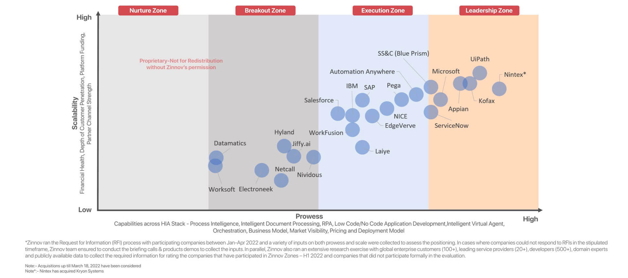
Zinnov Zones – Hyper Intelligent Automation 2022
Notes:
Here we see the results of the last 4 years of strategy of Kofax’ focus on Hyper Intelligent Automation.
Kofax has moved

Slide 12
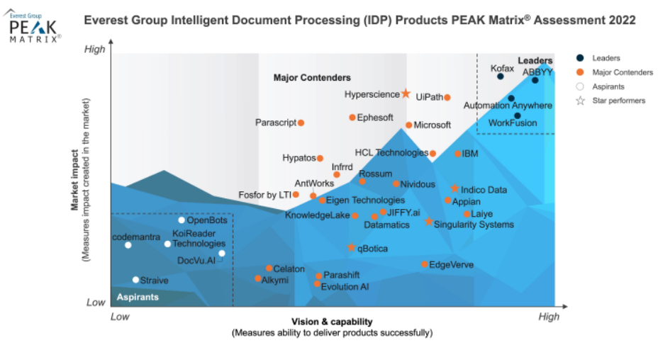
Leadership ranking in Intelligent Document Processing

Slide 13
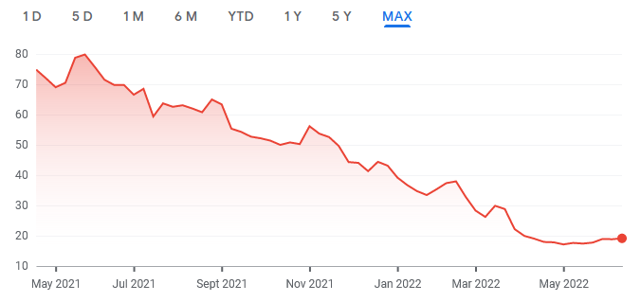
Where is Kofax today?
Software companies are seeing a reset in pricing
With inflation, Covid, Ukraine.
Kofax is growing while the market is being fearful.
Kofax was acquired by TA Associates and Clearlake in 2022, two reputable investor groups that sees Kofax as an opportunity in a turbulent market.
Kofax’ software is mission critical to our customers.
Kofax is pursuing a Cloud First Strategy
Cloud means focus on customer journey, not “top of funnel” selling.
FEAR
Investors are paying less for future earnings
Kofax processed 4 billion pages in the Cloud in 2021
Notes:
Many of Kofax’ customers are seeking solutions to the inflationary and supply chain issues that are preventing them from selling their goods and services at the margins they need.
Economic slowdown is always an opportunity for Kofax as we share the value of our automation solutions that remove cost and friction.
Cloud First means we can sell what the market needs today, not commoditized software of yesterday. Kofax has remarkable revenue growth in selling Cloud solutions in 2022. It is appealing and easier buy for customers.

Slide 14




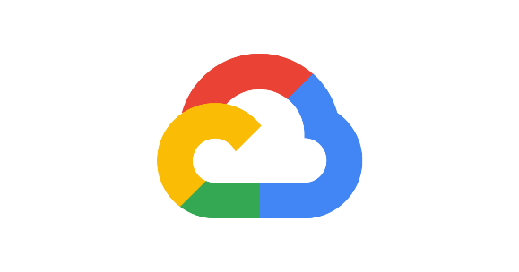

Our ‘Cloud Choice’ strategy supports enterprise customers that typically leverage a hybrid cloud environment
Kofax Cloud
Customer Cloud
On-Premises
Kofax SaaS on Microsoft Azure
Dedicated instance or Public Tenant
Term License
Support Included
Deploy in your preferred cloud
Customer Managed Data Center
Single Instance or Multi-Tenant (OPMT)
Perpetual or Term License
Separate Support Contract
containerization

Slide 15
Technology Innovation Roadmap at Kofax
Notes:
What is your vision and roadmap for your product and related offerings? How has it evolved over the last 12 months? What changed due to COVID-19?
Cloud – so the next area we are seeing this past year, is around capture in the cloud, more organizations are trusting the cloud, consumption has exploded due to covid, we have many cloud offerings across our product portfolio, but one I wanted to highlight is TotalAgility Cloud, and this is the ability to capture documents, perform analytics, and orchestrate business processes as part of our intelligent automation platform, we have a strategy to expand with RPA in the cloud as well as mobility and engagement in the cloud, so things like e-signature and digital identity verification, so moving that to the cloud as well. We run in Azure with a multi-tentant or dedicated options, we also have the ability to provide KTA to customers and have them deploy it in their own cloud, whichever they choose, whether that is Azure or AWS, we feel that is a key differentiator is the power of choice.
A need to interface with your on prem systems, on prem device, scanner or email server, or on ERP system that need to send documents to and from, so whether you are capturing from front end or back end, KTA provides an integration server which is a way to have one entry and exit point that sits on the customer premise point to allow them to do the communication between on prem and cloud, we are seeing more trust in the underlying architecture, there are certifications required in certain markets and certain verticals and we are sensitive to that. The reason people want to go dedicated is to control upgrade timing, pay a bit more and control when you upgrade to KTA. Entry level KTA is 10K on prem, a little higher than that for cloud, that’s just to get in, it goes up from there based on pages and users. $10k perpetual price. For term 3 or 5k per year, if it’s cloud you are closer to $20k range. You can get started pretty low amount of operating in the Cloud, and get started right away with 100k pages of capture. No disconnection charge.
We have other cloud offerings as well

Slide 16
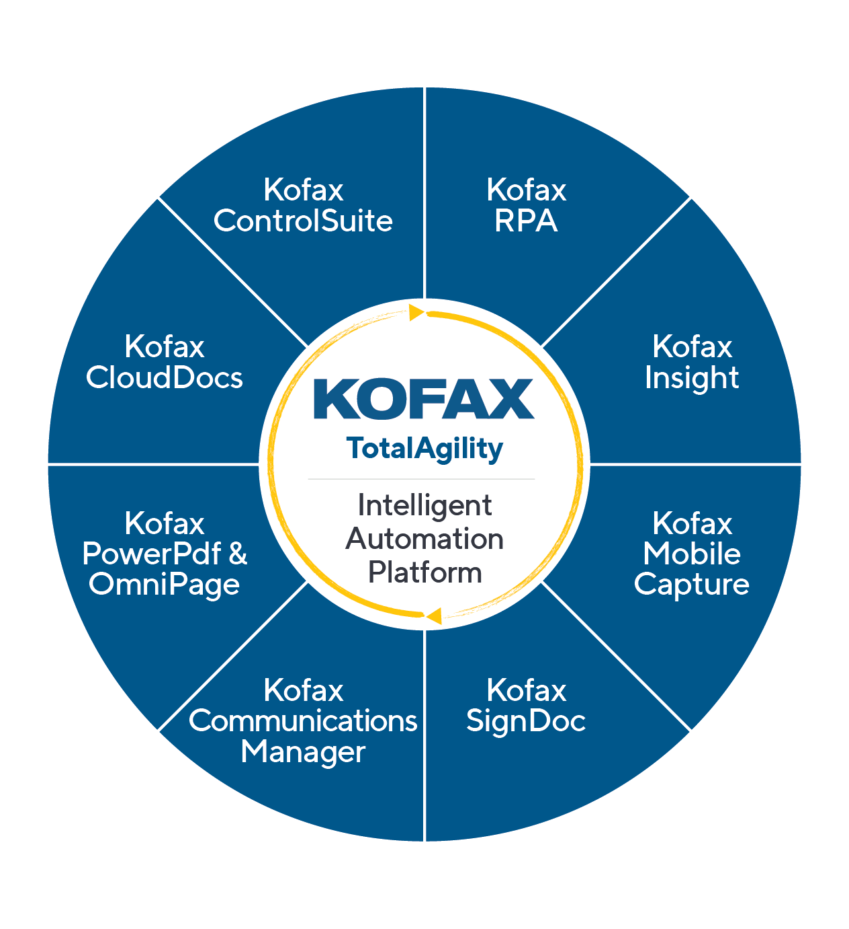
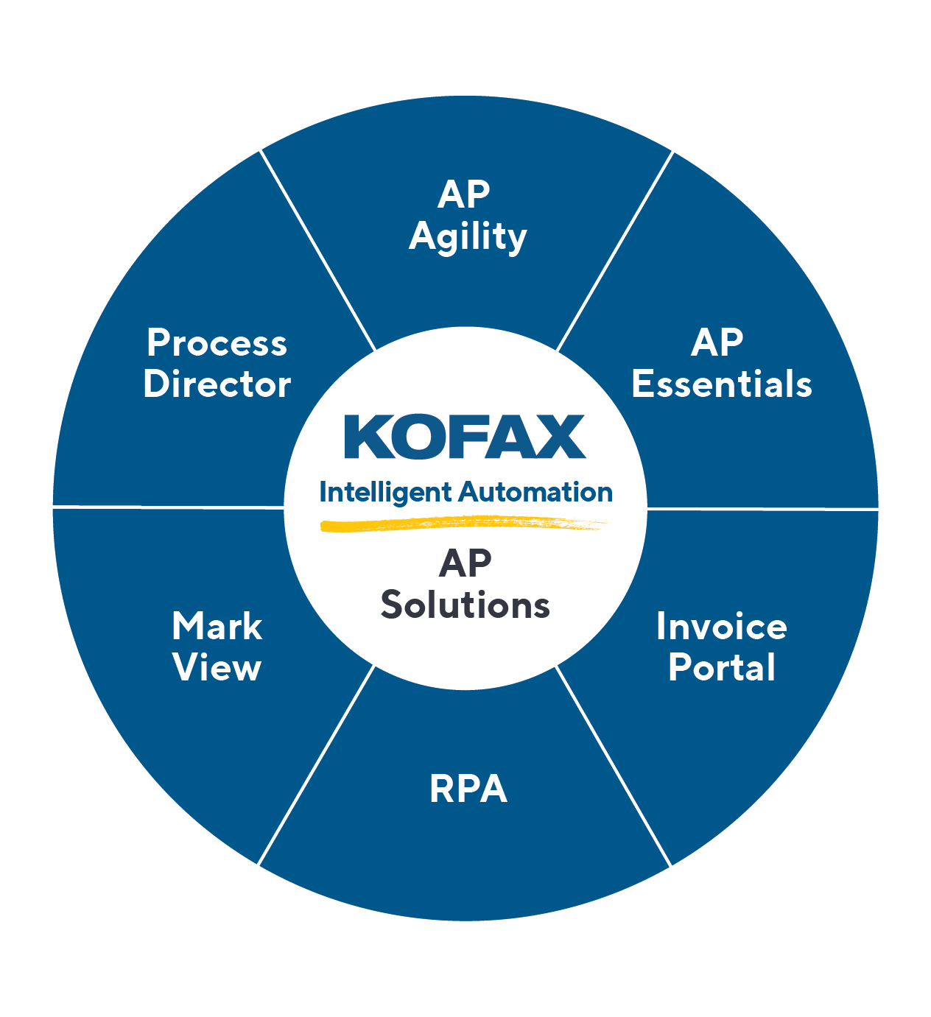
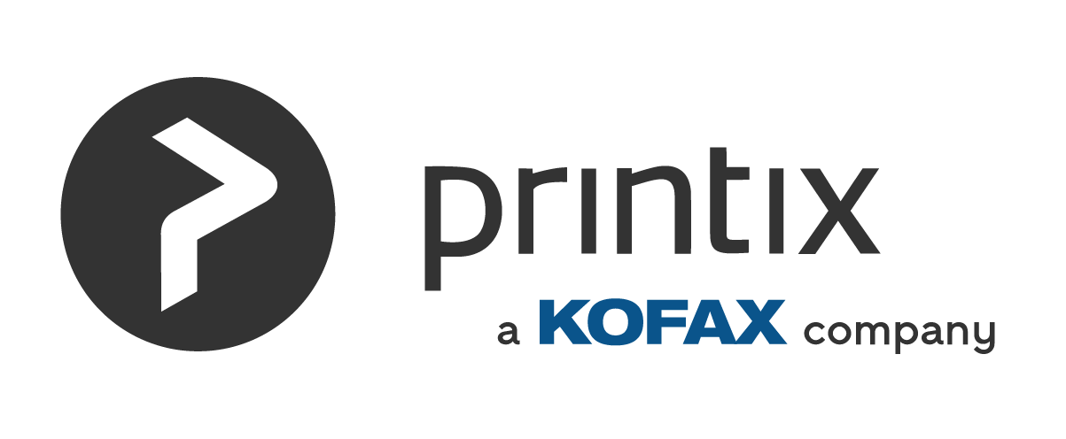
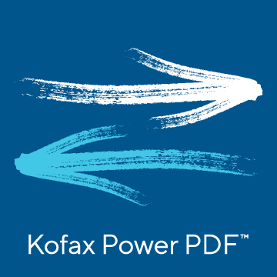
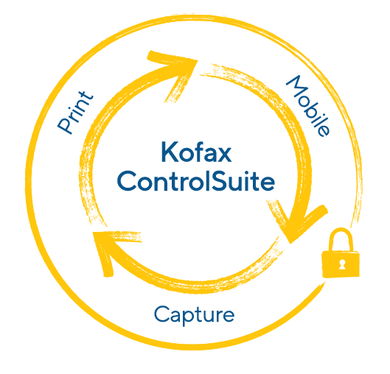
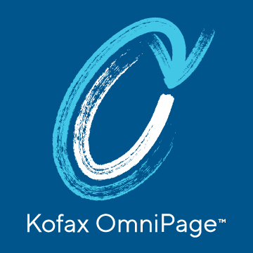

Our Automation Portfolio digitally transforms Content-Intensive Workflows… and differentiates us from the Competition
Kofax Automation
Intelligent Automation
Print Automation
Intelligent Automation Platform
Accounts Payable Solutions
Print Infrastructure & Management Platforms
Productivity Solutions
a global B2B e-invoicing network
Notes:
Throughout ‘22 we will continue to strengthen the integration of our comprehensive Automation portfolio that provides you the ability to penetrate different LOB customers with up and cross-sell potential
We will continue to win in the enterprise and SMB markets by focusing on what differentiates us from the competition
And what differentiates Kofax is our ability to use our Cognitive Capture heritage, coupled with our Workflow Orchestration strategy…to transform content-intensive workflows
This stands true across IA, AP, PA and Productivity
Focusing on Digitally Transforming ‘Content-Intensive’ Workflows is the way we expand from back-office document imaging use cases to front office complex content-intensive use cases WHILE differentiating ourselves from other Workflow solutions

